Slide 1
PIC Instructions

Slide 2
MOV - Data Transfer Instructions
MOVLW Immediate data - copy immediate data to WREG
MOVWF Destination – copy WREG to Destination
MOVF Register f, d
Copy contents of Register f to a destination depending on d and a.
If d=0, destination is WREG, else it is f.
Status register (Z) gets affected

Slide 3
ADD – Addition Instructions
ADDWF f,d – Contents of f and WREG are added
ADDWFC f,d – Contents of f, WREG and carry flag are added
If d=0, destination is WREG else it is f.
ADDLW Immediate data – Immediate data is added to WREG
Status register is affected

Slide 4
SUB – Subtraction instructions
SUBWF f,d ➔ f – WREG
SUBFWB f,d ➔ WREG(with Carry flag) – f
SUBWFB f,d ➔ f(with Carry flag) - WREG
If d=0, destination is WREG else it is f.
SUBLW Immediate data – Immediate data is subtracted from WREG
Status register is affected

Slide 5
CLRF f,d
Contents of register f are deleted and Z flag is set.
NEGF f,d
Contents of register f are negated using two’s complement method.
Status register is updated
COMF f,d
Contents of register f are complemented using one’s complement method.
Status register is updated
If d=0, result is stored in WREG, else it is in f.
Default value of d is 1.

Slide 6
Access bank specifier
Opcode f,d,a
d and a are optional
If a=0, select the access bank
If a=1, bank is specified by BSR

Slide 7
INCF f,d
Increment file register f
INCFSZ f,d
Increment file register f and skip the next instruction if f is zero
INCFSNZ f,d
Increment file register f and skip the next instruction if f is not zero

Slide 8
DECF f,d
Decrement file register f
DECFSZ f,d
Decrement file register f and skip the next instruction if f is zero
DECFSNZ f,d
Decrement file register f and skip the next instruction if f is not zero

Slide 9
Logic instructions
ANDLW Immediate data
ANDWF f,d
IORLW Immediate data
IORWF f,d
XORLW Immediate data
XORWF f,d

Slide 10
CLRF f
Contents of register f are deleted and Z flag is set.
NEGF f
Contents of register f are negated using two’s complement method.
Status register is updated
COMF f
Contents of register f are complemented using one’s complement method.
Status register is updated
Destination is f, as d is not mentioned , thus =1 (default)

Slide 11
RLCF f,d
Rotate left file register f, through carry flag
RLNCF f,d
Rotate left file register f (not through carry flag)
RRCF f,d
Rotate right file register f, through carry flag
RRNCF f,d
Rotate right file register f (not through carry flag)

Slide 12
Rotate left through carry(1)
Data = 58h
(01011000 → 1) ➔(10110001 →0)
10110000 - RLFNCF

Slide 13
SWAPF f,d
Swap nibbles in file register f.
Ex. if f has data 35h
After SWAPF instruction, data becomes 53h

Slide 14
Bit b ranges from 0 to7
BCF f,b → clear bit b
BSF f,b → set bit b
BTG f,b → toggle (complement) bit b
10110010
BCF f,5 ➔ 10010010
BSF f,0 ➔ 10110011
BTG f,7 ➔00110010

Slide 15
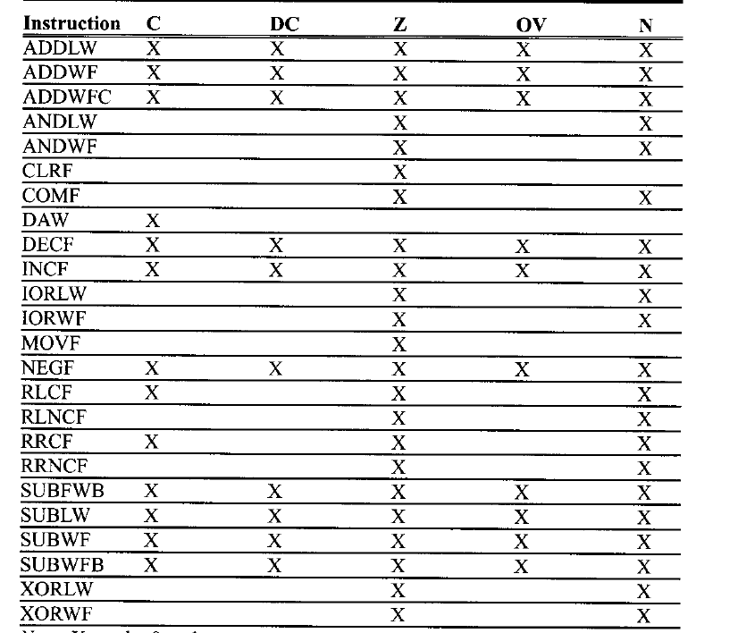

Slide 16
Directives
ORG
END
EQU
SET
LIST ➔ LIST target chip Ex. LIST PIC18F458
#include
radix ➔ radix dec

Slide 17
Assign value to a variable
A EQU 5
B SET 10
The value of A cannot be reassigned
The value of B can be reassigned

Slide 18
X EQU a
a is hexadecimal by default
a can be in the format (hex)
N, 0xN, NH, Nh, H’N’, h’N’
a can be in the format (decimal)
D’N’, d’N’
a can be in the format (binary)
B’N’, b’N’,
a can be in the format (ASCII)
A’L’, a’L’, ‘L’

Slide 19
A EQU 41
B EQU 0x41
C EQU H’41’
D EQU D’65’
E EQU B’1000001’
F EQU ‘A’
G EQU A’A’

Slide 20
GOTO Instruction
GOTO xyz
xyz:

Slide 21
BNZ Instruction
Branch if not zero
➔ DECF
BNZ addr

Slide 22
BZ – Branch if zero
BNC – Branch if no carry
BTFSC f,b → bit test skip next instruction if clear
BTFSS f,b → bit test skip next instruction if set

Slide 23
Function call
CALL name-of-function
name-of-function
----
RETURN

